Slide 1
Data structures and algorithm
Sorting
Dr. Seemab Latif
Lecture No. 15
12th January, 2011

Slide 2
Sorting
A process that organizes a collection of data into either ascending or descending order.
Can be used as a first step for searching the data.
Binary Search required a sorted array.

Slide 3
Sorting Algorithms
Selection Sort
Insertion Sort
Bubble Sort
Quick Sort
Merge Sort
Heap Sort

Slide 4
Selection Sort
Select the smallest value from the list.
Bring it to the first location of the list.
Find the next value and repeat the process by swapping the locations.

Slide 5
Example: Selection Sort
26 33 43 100 46 88 52 17 53 77
17 | 33 43 100 46 88 52 26 53 77
17 26 | 43 100 46 88 52 33 53 77
17 26 33 | 100 46 88 52 43 53 77
17 26 33 43 | 46 88 52 100 53 77
17 26 33 43 46 | 88 52 100 53 77
17 26 33 43 46 52 | 88 100 53 77
17 26 33 43 46 52 53 | 100 88 77
17 26 33 43 46 52 53 77 | 88 100
17 26 33 43 46 52 53 77 88 | 100

Slide 6
Selection Sort
void selectionSort(int numbers[ ], int array_size)
{
int i, j;
int min, temp;
for (i = 0; i < array_size-1; i++)
{
min = i;
for (j = i+1; j < array_size; j++)
{
if (numbers[j] < numbers[min])
min = j;
}
temp = numbers[i];
numbers[i] = numbers[min];
numbers[min] = temp;
}
}

Slide 7
Insertion Sort
Given an unsorted list.
Partition the list into two regions: sorted & unsorted.
At each step, take the first item from unsorted and place it into its correct position.
Also requires to shift the remaining items to make a room for the inserted item.

Slide 8
Example: Insertion Sort
99 | 55 4 66 28 31 36 52 38 72
55 99 | 4 66 28 31 36 52 38 72
4 55 99 | 66 28 31 36 52 38 72
4 55 66 99 | 28 31 36 52 38 72
4 28 55 66 99 | 31 36 52 38 72
4 28 31 55 66 99 | 36 52 38 72
4 28 31 36 55 66 99 | 52 38 72
4 28 31 36 52 55 66 99 | 38 72
4 28 31 36 38 52 55 66 99 | 72
4 28 31 36 38 52 55 66 72 99 |

Slide 9
Insertion Sort Algorithm
void insertionSort(int array[], int length)
{
int i, j, value;
for(i = 1; i < length; i++)
{
value = a[i];
for (j = i - 1; j >= 0 && a[ j ] > value; j--)
{
a[j + 1] = a[ j ];
}
a[j + 1] = value;
}
}

Slide 10
Bubble Sort
Bubble sort is similar to selection sort in the sense that it repeatedly finds the largest/smallest value in the unprocessed portion of the array and puts it back.
However, finding the largest value is not done by selection this time.
We "bubble" up the largest value instead.

Slide 11

Bubble Sort
Compares adjacent items and exchanges them if they are out of order.
Comprises of several passes.
In one pass, the largest value has been “bubbled” to its proper position.
In second pass, the last value does not need to be compared.

Slide 12
Bubble Sort
void bubbleSort (int a[ ], int n)
{
int i, j, temp, flag;
for(i=n-1; i>0; i- -)
{
flag = 1;
for(j=0; i>j; j++)
{
if(a[j]>a[j+1])
{
flag = 0;
temp = a[j];
a[j] = a[j+1];
a[j+1] = temp;
}
} //out this block when flag is true, i.e. inner loop performed no swaps, so the list is already sorted
if(flag)
break;
}
}

Slide 13
Bubble Sort Example
9, 6, 2, 12, 11, 9, 3, 7
6, 9, 2, 12, 11, 9, 3, 7
Bubblesort compares the numbers in pairs from left to right exchanging when necessary. Here the first number is compared to the second and as it is larger they are exchanged.
6, 2, 9, 12, 11, 9, 3, 7
Now the next pair of numbers are compared. Again the 9 is the larger and so this pair is also exchanged.
6, 2, 9, 12, 11, 9, 3, 7
In the third comparison, the 9 is not larger than the 12 so no exchange is made. We move on to compare the next pair without any change to the list.
6, 2, 9, 11, 12, 9, 3, 7
The 12 is larger than the 11 so they are exchanged.
6, 2, 9, 11, 9, 12, 3, 7
The twelve is greater than the 9 so they are exchanged
The end of the list has been reached so this is the end of the first pass. The twelve at the end of the list must be largest number in the list and so is now in the correct position. We now start a new pass from left to right.
6, 2, 9, 11, 9, 3, 12, 7
The 12 is greater than the 3 so they are exchanged.
6, 2, 9, 11, 9, 3, 7, 12
The 12 is greater than the 7 so they are exchanged.

Slide 14
Bubble Sort Example
First Pass
6, 2, 9, 11, 9, 3, 7, 12
Second Pass
6, 2, 9, 11, 9, 3, 7, 12
2, 6, 9, 11, 9, 3, 7, 12
2, 6, 9, 9, 11, 3, 7, 12
2, 6, 9, 9, 3, 11, 7, 12
2, 6, 9, 9, 3, 7, 11, 12
Notice that this time we do not have to compare the last two numbers as we know the 12 is in position. This pass therefore only requires 6 comparisons.

Slide 15
Bubble Sort Example
First Pass
6, 2, 9, 11, 9, 3, 7, 12
Second Pass
2, 6, 9, 9, 3, 7, 11, 12
Third Pass
2, 6, 9, 9, 3, 7, 11, 12
2, 6, 9, 3, 9, 7, 11, 12
2, 6, 9, 3, 7, 9, 11, 12
This time the 11 and 12 are in position. This pass therefore only requires 5 comparisons.

Slide 16
Bubble Sort Example
First Pass
6, 2, 9, 11, 9, 3, 7, 12
Second Pass
2, 6, 9, 9, 3, 7, 11, 12
Third Pass
2, 6, 9, 3, 7, 9, 11, 12
Fourth Pass
2, 6, 9, 3, 7, 9, 11, 12
2, 6, 3, 9, 7, 9, 11, 12
2, 6, 3, 7, 9, 9, 11, 12
Each pass requires fewer comparisons. This time only 4 are needed.

Slide 17
Bubble Sort Example
First Pass
6, 2, 9, 11, 9, 3, 7, 12
Second Pass
2, 6, 9, 9, 3, 7, 11, 12
Third Pass
2, 6, 9, 3, 7, 9, 11, 12
Fourth Pass
2, 6, 3, 7, 9, 9, 11, 12
Fifth Pass
2, 6, 3, 7, 9, 9, 11, 12
2, 3, 6, 7, 9, 9, 11, 12
The list is now sorted but the algorithm does not know this until it completes a pass with no exchanges.

Slide 18
Merge Sort
Merge sort is a sorting algorithm for rearranging lists (or any other data structure that can only be accessed sequentially) into a specified order.
It is a particularly good example of the divide and conquer algorithmic paradigm.

Slide 19
Merge Sort
Conceptually, merge sort works as follows:
Divide the unsorted list into two sub-lists of about half the size.
Sort each of the two sub-lists.
Merge the two sorted sub-lists back into one sorted list.

Slide 20
Merge Sort
Array mergeSort(Array m)
Array left, right.
if length(m) ≤ 1
return m
else
middle = length(m) / 2
for each x in m up to middle
add x to left
for each x in m after middle
add x to right
left = mergesort(left)
right = mergesort(right)
result = merge(left, right)
return result

Slide 21
Merge Sort
Array merge(left,right)
Array result
while length(left) > 0 and length(right) > 0
if first(left) ≤ first(right)
append first(left) to result
left = rest(left)
else
append first(right) to result
right = rest(right)
if length(left) > 0
append left to result
if length(right) > 0
append right to result
return result

Slide 22
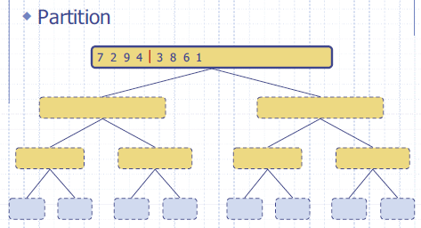
Execution Example

Slide 23
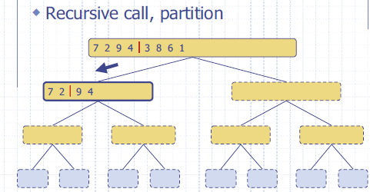
Execution Example

Slide 24
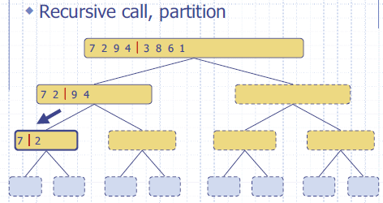
Execution Example

Slide 25
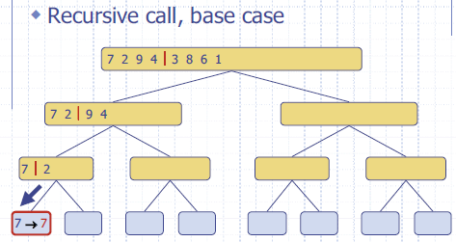
Execution Example

Slide 26
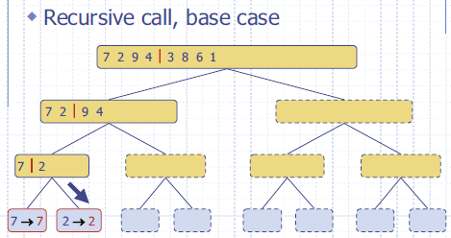
Execution Example

Slide 27
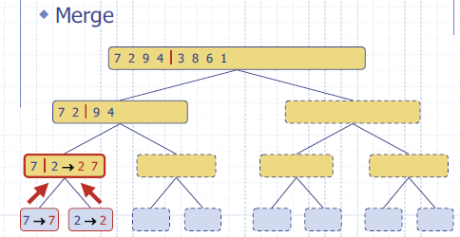
Execution Example

Slide 28
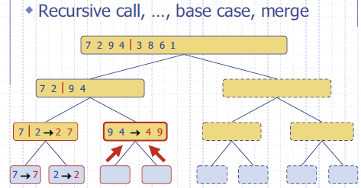
Execution Example

Slide 29
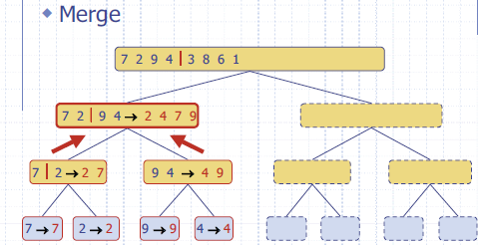
Execution Example

Slide 30
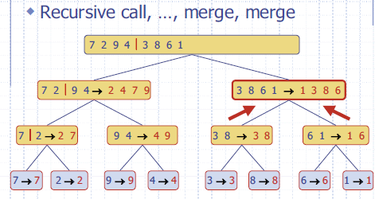
Execution Example

Slide 31
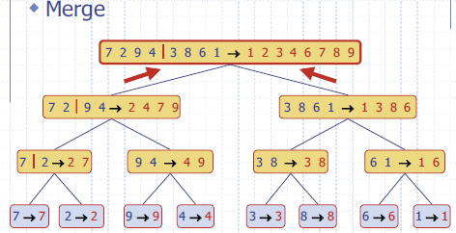
Execution Example

Slide 32
Quick Sort
Quicksort sorts by employing a divide and conquer strategy to divide a list into two sub-lists.
The steps are:
Pick an element, called a pivot, from the list.
Reorder the list so that all elements which are less than the pivot come before the pivot and so that all elements greater than the pivot come after it (equal values can go either way).
After this partitioning, the pivot is in its final position. This is called the partition operation.
Recursively sort the sub-list of lesser elements and the sub-list of greater elements.

Slide 33
Quick Sort
Choose the appropriate pivot, either randomly or near the median of the array elements.
Avoid a pivot which makes either of the two halves empty.

Slide 34
Quick Sort
function quicksort(list q)
list low, pivotList, hi
if length(q) ≤ 1
return q
select a pivot value from q
for each x in q except the pivot element
if x < pivot then add x to low
if x ≥ pivot then add x to high
add pivot to pivotList
return concatenate(quicksort(less), pivotList, quicksort(greater))

Slide 35
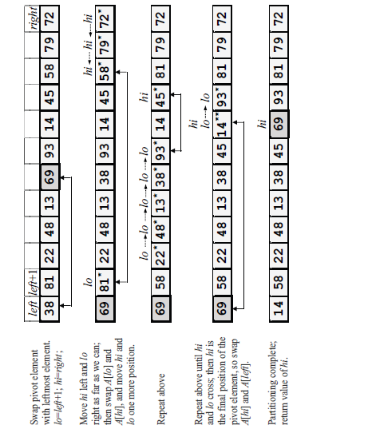
Execution

Slide 36
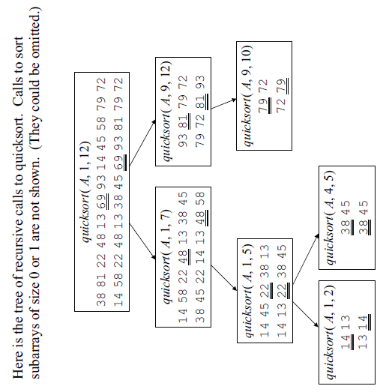
Execution

Slide 37
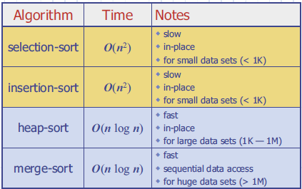
Summary of Sorting Algorithms

Slide 38
HEAP SORT

Slide 39
What is a “heap”?
Definitions of heap:
A large area of memory from which the programmer can allocate blocks as needed, and deallocate them (or allow them to be garbage collected) when no longer needed
A balanced, left-justified binary tree in which no node has a value greater than the value in its parent
These two definitions have little in common
Heapsort uses the second definition

Slide 40
Balanced binary trees
Recall:
The depth of a node is its distance from the root
The depth of a tree is the depth of the deepest node
A binary tree of depth n is balanced if all the nodes at depths 0 through n-2 have two children
n-2
n-1
n
Balanced
Balanced
Not balanced

Slide 41
Left-justified binary trees
A balanced binary tree of depth n is left-justified if:
it has 2^{n} nodes at depth n (the tree is “full”), or
it has 2^{k} nodes at depth k, for all k < n, and all the leaves at depth n are as far left as possible
Left-justified
Not left-justified

Slide 42
Plan of attack
First, we will learn how to turn a binary tree into a heap
Next, we will learn how to turn a binary tree back into a heap after it has been changed in a certain way
Finally (this is the cool part) we will see how to use these ideas to sort an array

Slide 43
The heap property
A node has the heap property if the value in the node is as large as or larger than the values in its children
12
12
12
8
3
8
12
8
14
Blue node has heap property
Blue node has heap property
Blue node does not have heap property
All leaf nodes automatically have the heap property
A binary tree is a heap if all nodes in it have the heap property

Slide 44
siftUp
Given a node that does not have the heap property, you can give it the heap property by exchanging its value with the value of the larger child
12
14
8
14
8
12
Blue node does not have heap property
Blue node has heap property
This is sometimes called sifting up
Notice that the child may have lost the heap property

Slide 45
Constructing a heap I
A tree consisting of a single node is automatically a heap
We construct a heap by adding nodes one at a time:
Add the node just to the right of the rightmost node in the deepest level
If the deepest level is full, start a new level
Examples:
Add a new node here
Add a new node here

Slide 46
Constructing a heap II
Each time we add a node, we may destroy the heap property of its parent node
To fix this, we sift up
But each time we sift up, the value of the topmost node in the sift may increase, and this may destroy the heap property of its parent node
We repeat the sifting up process, moving up in the tree, until either
We reach nodes whose values don’t need to be swapped (because the parent is still larger than both children), or
We reach the root

Slide 47
Constructing a heap III
8
8
10
10
10
8
8
5
1
2
3
10
10
12
8
5
12
5
10
5
12
8
8
4

Slide 48
Other children are not affected
12
12
14
10
5
14
5
12
5
8
14
8
10
8
10
The node containing 8 is not affected because its parent gets larger, not smaller
The node containing 5 is not affected because its parent gets larger, not smaller
The node containing 8 is still not affected because, although its parent got smaller, its parent is still greater than it was originally

Slide 49
A sample heap
Here’s a sample binary tree after it has been heapified
25
22
17
19
22
14
15
18
14
21
3
9
11
Notice that heapified does not mean sorted
Heapifying does not change the shape of the binary tree; this binary tree is balanced and left-justified because it started out that way

Slide 50
Removing the root (animated)
Notice that the largest number is now in the root
Suppose we discard the root:
11
22
17
19
22
14
15
18
14
21
3
9
11
How can we fix the binary tree so it is once again balanced and left-justified?
Solution: remove the rightmost leaf at the deepest level and use it for the new root

Slide 51
The reHeap method I
Our tree is balanced and left-justified, but no longer a heap
However, only the root lacks the heap property
11
22
17
19
22
14
15
18
14
21
3
9
We can siftUp() the root
After doing this, one and only one of its children may have lost the heap property

Slide 52
The reHeap method II
Now the left child of the root (still the number 11) lacks the heap property
22
11
17
19
22
14
15
18
14
21
3
9
We can siftUp() this node
After doing this, one and only one of its children may have lost the heap property

Slide 53
The reHeap method III
Now the right child of the left child of the root (still the number 11) lacks the heap property:
22
22
17
19
11
14
15
18
14
21
3
9
We can siftUp() this node
After doing this, one and only one of its children may have lost the heap property —but it doesn’t, because it’s a leaf

Slide 54
The reHeap method IV
Our tree is once again a heap, because every node in it has the heap property
22
22
17
19
21
14
15
18
14
11
3
9
Once again, the largest (or a largest) value is in the root
We can repeat this process until the tree becomes empty
This produces a sequence of values in order largest to smallest

Slide 55
Sorting
What do heaps have to do with sorting an array?
Here’s the neat part:
Because the binary tree is balanced and left justified, it can be represented as an array
Danger Will Robinson: This representation works well only with balanced, left-justified binary trees
All our operations on binary trees can be represented as operations on arrays
To sort:
heapify the array;
while the array isn’t empty {
remove and replace the root;
reheap the new root node; }

Slide 56
Mapping into an array
25
22
17
19
22
14
15
18
14
21
3
9
11
0 1 2 3 4 5 6 7 8 9 10 11 12
25
22
17
19
22
14
15
18
14
21
3
9
11
Notice:
The left child of index i is at index 2*i+1
The right child of index i is at index 2*i+2
Example: the children of node 3 (19) are 7 (18) and 8 (14)

Slide 57
Removing and replacing the root
The “root” is the first element in the array
The “rightmost node at the deepest level” is the last element
Swap them...
0 1 2 3 4 5 6 7 8 9 10 11 12
25
22
17
19
22
14
15
18
14
21
3
9
11
0 1 2 3 4 5 6 7 8 9 10 11 12
11
22
17
19
22
14
15
18
14
21
3
9
25
...And pretend that the last element in the array no longer exists—that is, the “last index” is 11 (containing the value 9)

Slide 58
Reheap and repeat
Reheap the root node (index 0, containing 11)...
0 1 2 3 4 5 6 7 8 9 10 11 12
11
22
17
19
22
14
15
18
14
21
3
9
25
0 1 2 3 4 5 6 7 8 9 10 11 12
22
22
17
19
21
14
15
18
14
11
3
9
25
0 1 2 3 4 5 6 7 8 9 10 11 12
9
22
17
19
22
14
15
18
14
21
3
22
25
...And again, remove and replace the root node
Remember, though, that the “last” array index is changed
Repeat until the last becomes first, and the array is sorted!

